Slide 1
Proofs
By Ariel Avshalom
Lecture 5 – proofs involving sets and if and only if

Slide 2

Laws from Chapter 2
A × B = { (x, y) : x ∈ A, y ∈ B}
A ∪ B = {x : (x ∈ A)∨(x ∈ B)}
A ∩ B = {x : (x ∈ A)∧(x ∈ B)}
A − B = {x : (x ∈ A)∧(x ∉ B)}
$A^{c}$ = U − A.

Slide 3

Prove $a ∈A$
Sets are usually constructed because the elements in them share some common property.
Example:
{x : x is an odd integer}= {...,−5,−3,−1,1,3,5,...}
Elements in this set are integers with this property: n%2 = 1
So to prove that some number n is in this set we need to show that n%2 = 1
It also should be apparent that the number has to be an integer

Slide 4


Proving $A\text{⊆}\text{B}$
We just showed how to prove that one element is in a set, but how do we do this for many elements like
$$\text{ℕ} ∈ \text{ℤ}$$
There are 2 ways to go about this, either by direct proof or by contradiction
Why can’t we use contrapositive?
Direct Proof Method: https://www.youtube.com/watch?v=3qzykhjtQzU

Slide 5

Prove that {x ∈ ℤ : 18| x } ⊆ {x ∈ ℤ : 6| x}
Example elements in A = {x ∈ ℤ : 18| x }
-18,0,18,36…
Example elements in B = {x ∈ ℤ : 6| x}
0,6,12,18,24…
$$We need to show that For ∀ a ∈A, a=6z where z∈ \text{ℤ}$$
Show that everything in A is in B:
$$For ∀ a ∈A, a=18z where z∈ \text{ℤ}$$
Then
$$a = 6\left(3z\right) \text{⊆} \text{B}$$
$$∀ a ∈A and ∀ a ∈B$$
$$A \text{⊆} \text{B}$$

Slide 6

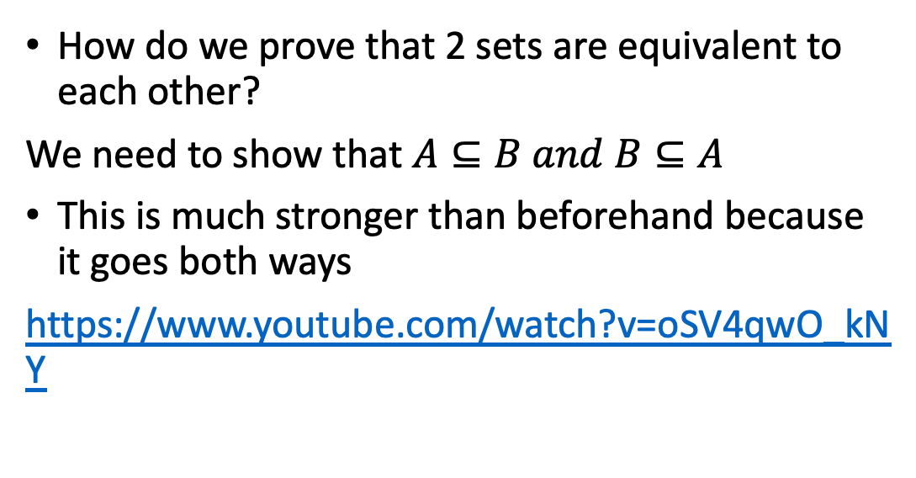
Proving A = B
How do we prove that 2 sets are equivalent to each other?
We need to show that $A⊆B and B⊆A$
This is much stronger than beforehand because it goes both ways
https://www.youtube.com/watch?v=oSV4qwO_kNY

Slide 7
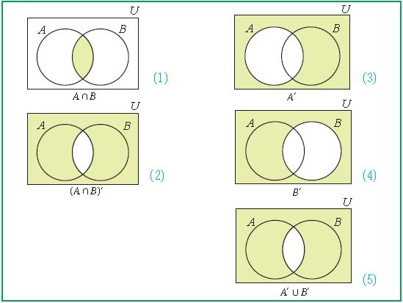
DeMorgan’s law

Slide 8


Proving ${\left(A U B\right)}^{c}=(A^{c} \text{∩ } B^{c})$
Let P = ${\left(A U B\right)}^{c}$, Q $=\left(A^{c}\text{ ∩ }B^{c}\right)$
Then let$x ∈P$
$$x \text{∉} \left(A U B\right)$$
$$x ∉ A and x ∉ B$$
$$x ∈ A^{c} and x ∈ B^{c}$$
$$x ∈ A^{c} ∩ B^{c}$$
Therefore, $x ∈ Q$
And $P ⊂ Q$

Slide 9


The other direction:
Let P = ${\left(A U B\right)}^{c}$, Q $=\left(A^{c}\text{ ∩ }B^{c}\right)$
Then let$y ∈Q$
$$y∈A^{c} and y∈B^{c}$$
$$y \text{∉} A and y ∈ B$$
$$\text{y} \text{∉} A U B$$
$$y ∈{\left(A U B\right)}^{c}$$
Therefore, $y ∈ P$
And $Q ⊂ P$

Slide 10

We proved the first statement, now prove this: ${\left(A ∩ B\right)}^{c} = A^{c} U B^{c}$
This is assigned to you and will be your first quiz question.
I recommend trying it yourself before you start looking online. It is very similar to the other proof.

